Slide 1

FYP
Name: fannie.bichemin@ensea.fr
Student Number: X326889
Course: Internship in the field of electronics & computer sciences
Phone Number (Mobile): +33(0)633828848
Address: York Street - Belfast
Placement – xxxxxx

Slide 2
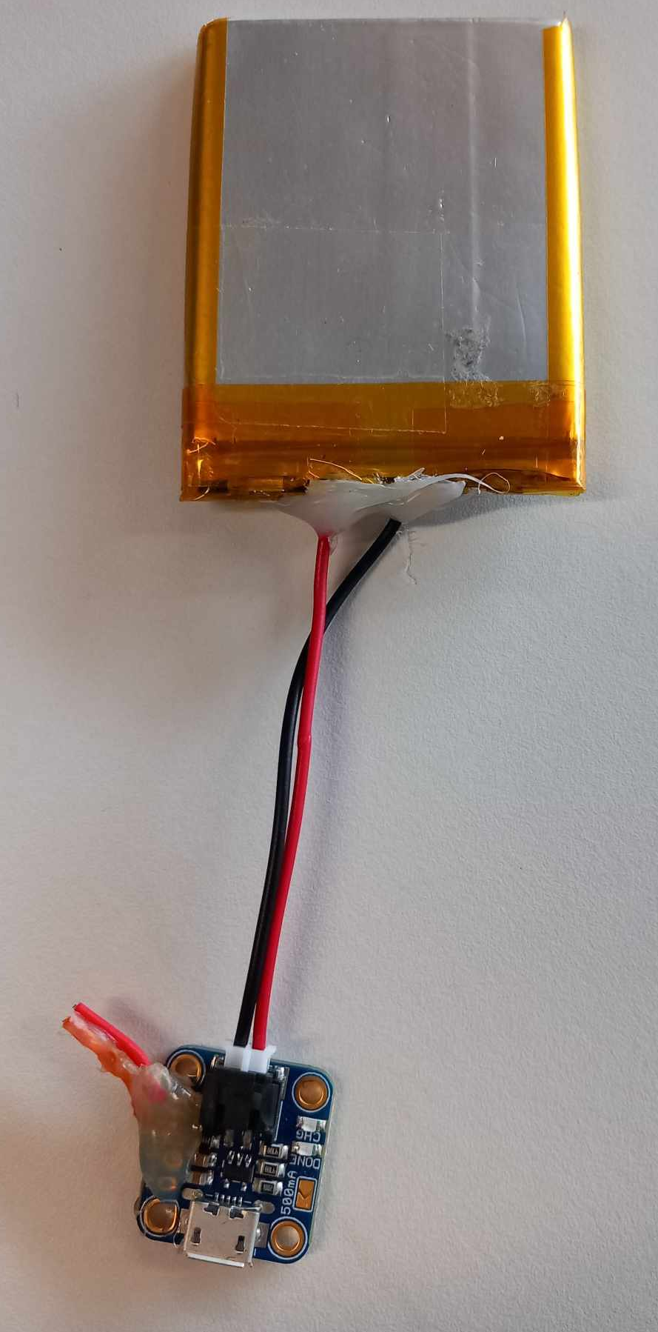
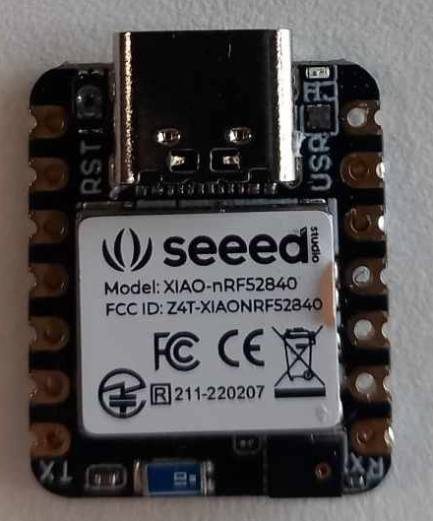
Week n°1 : April 15 to April 21
Arduino : IDE download & start-up (LEDs blinking, use of sensor )
OpenMV IDE : programs testing / parameter modification
Camera h7 r2 :
→ Discovery and research on PCB (features /values of voltage and current)
→ Circuit board diagram
→ Start of the new PCB (removal of some components and addition of new ones )
→ Discovery and research on the LiPoly/LiIon battery charger
→ Discovery and research on the XIAO nRF52840 Sense module
→ Reading documents/program testing on the Bluetooth module Programming
(Nordic website)

Slide 3
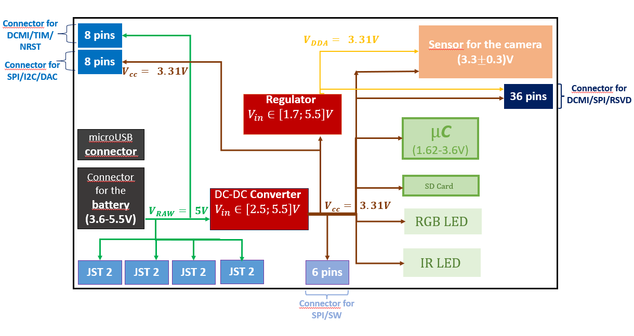
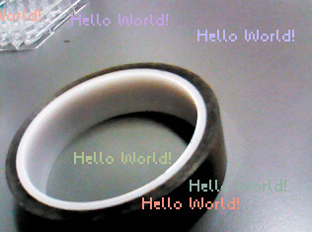
Week n°1 : Annex
Fig.1: Test of the program "text_drawings"
Fig.2: Creation of a diagram to explain the electronic board

Slide 4
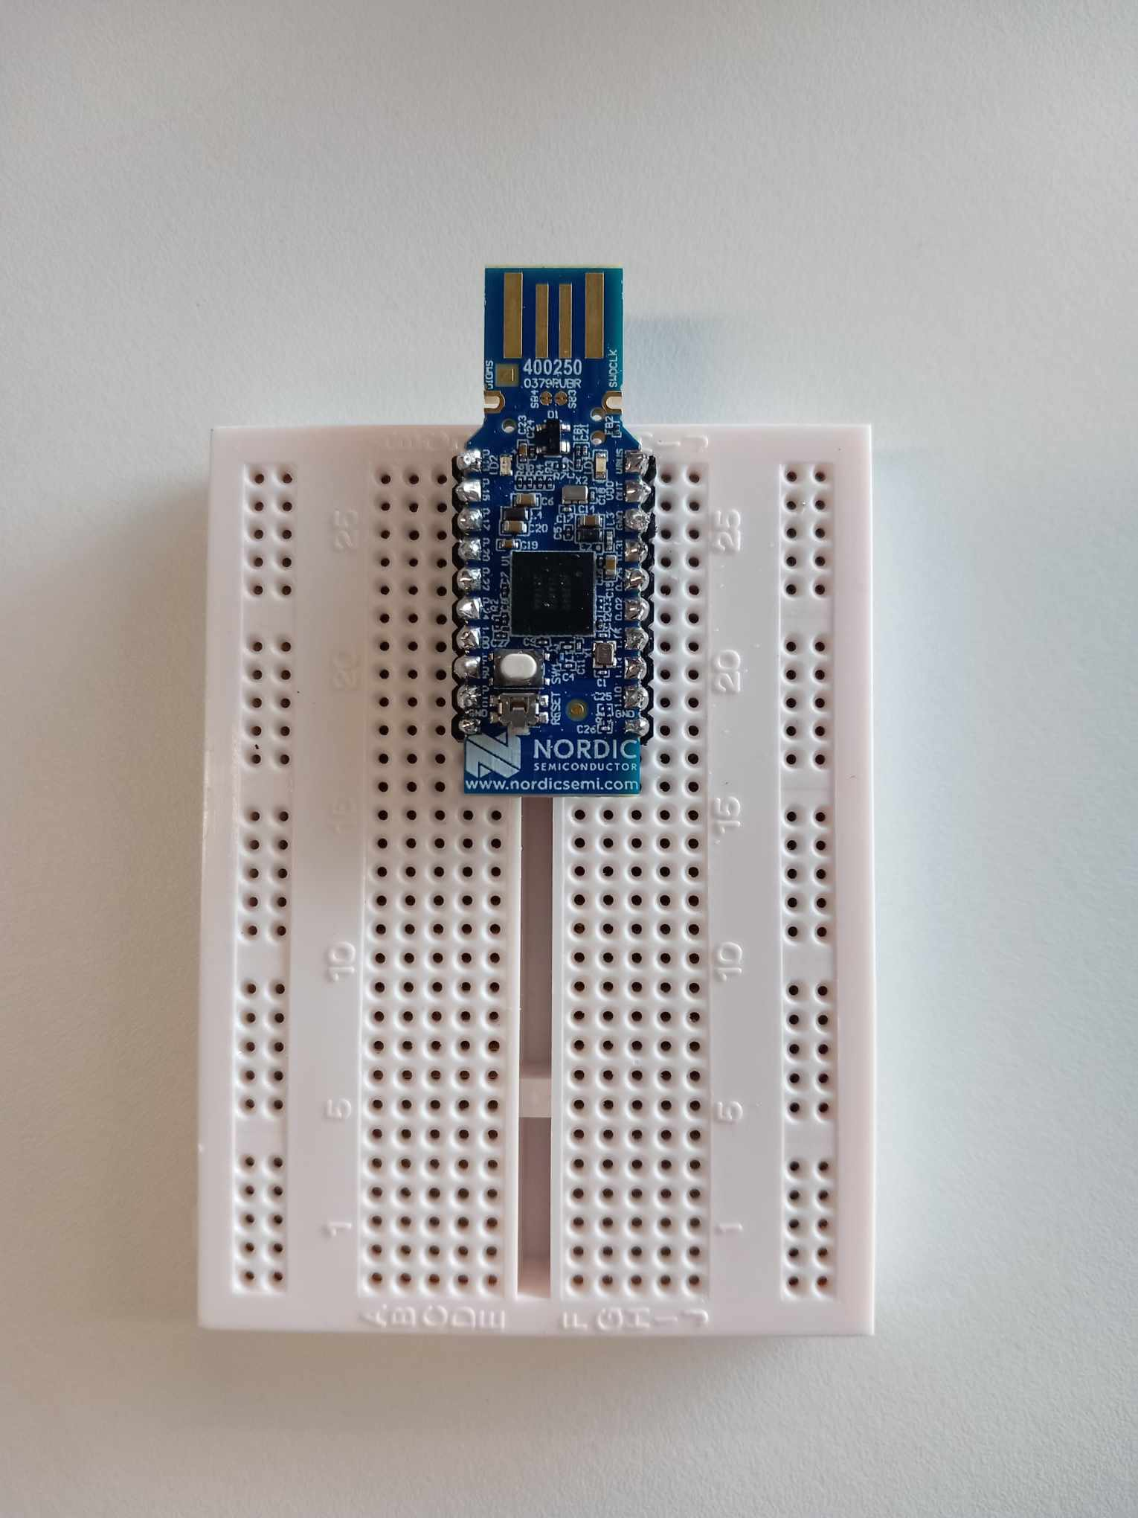
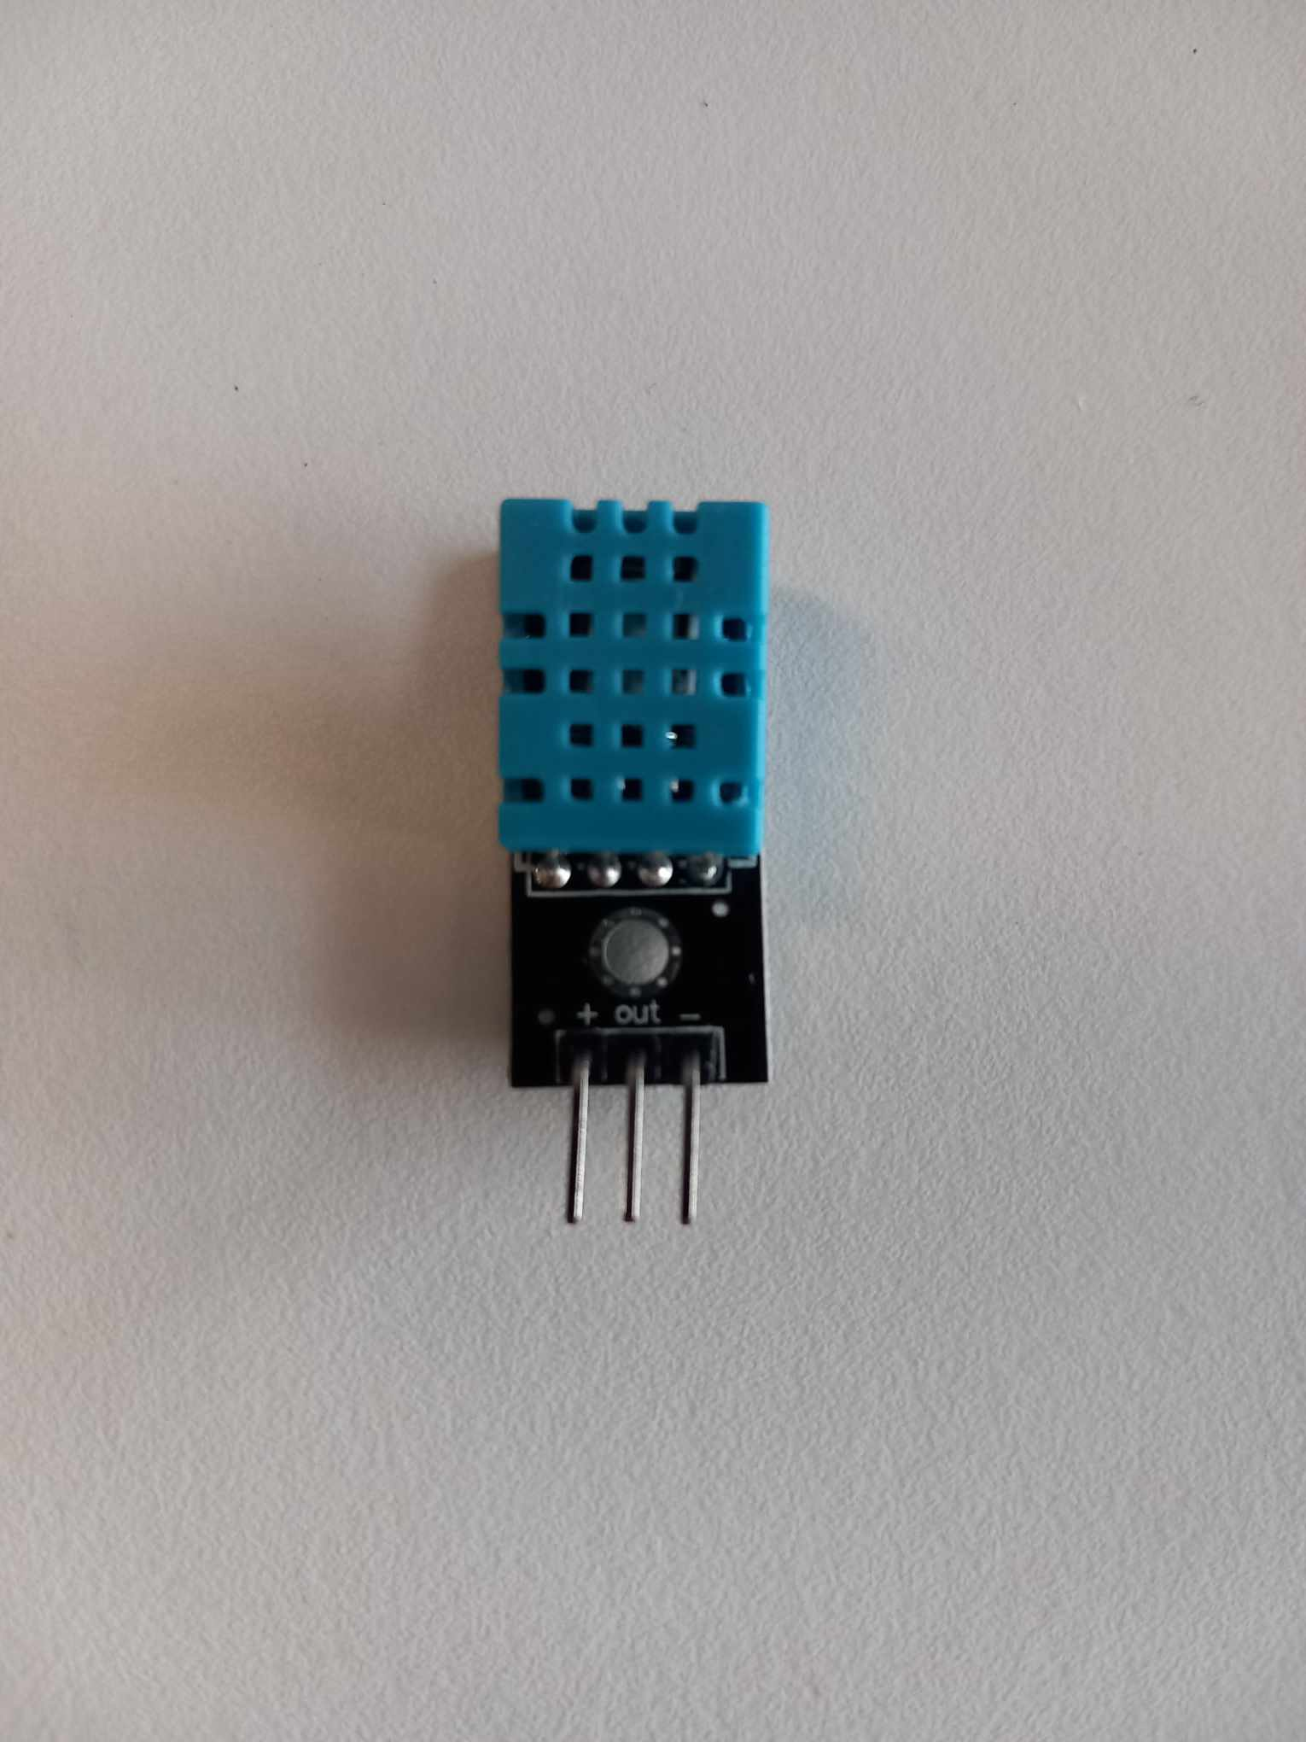
Week n°2 : April 22 to April 28
NRF Connect: → Start-up
→ First code : Bluetooth communication (data sending) with a mobile phone app
→ Parameter testing
→ Learning how to use nRF52840 dongle / computer code testing
Temperature & Humidity sensor (DHT 11 ):
→ Research on several websites
→ Code / test with Arduino
→ Try to Code with visual code and then with microVision (packages and compiler download )
PCB of Camera h7 r2 :
→ Adding components-footprints : USB-C port and xiaonRF52840
→ Datasheet Reading : in order to connect new components with the old ones

Slide 5
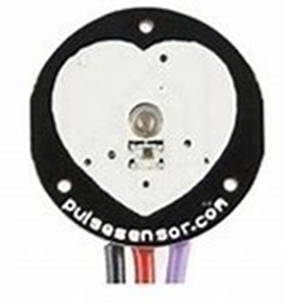
Week n°3 : April 29 to May 05
Pulse Sensor :
→ Discovery and research on several websites
→ Compilation of code examples provided by Arduino libraries (many accuracy problems)
→ Discovery and implementation of Mbed / Keil Studio
→ Compilation of codes to use pulse sensor with Mbed Studio
→ Try correcting errors found in computer codes
→ Try broadcasting data thanks to Bluetooth module (xiaonrf52840) with nrf Connect app and with Visual Code

Slide 6
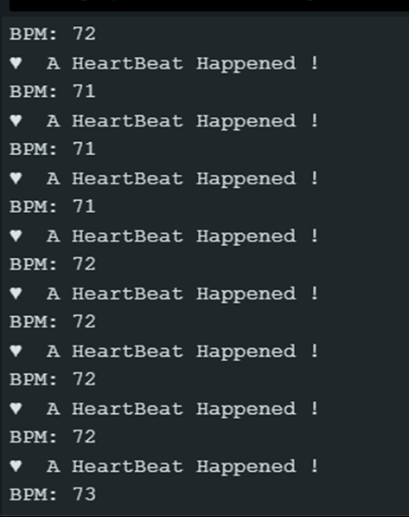
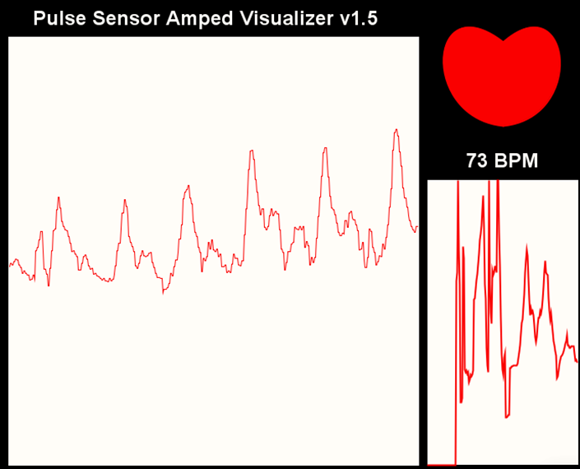
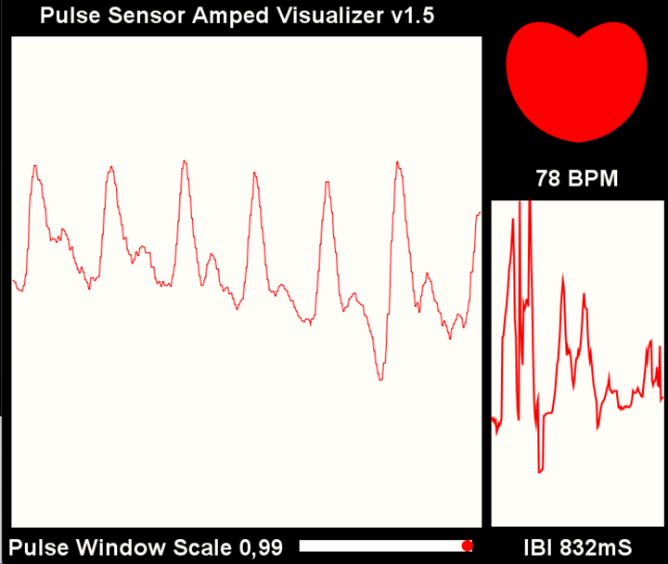
Week n°3 : Annex
→ Displays all the data that the Arduino receives
→ Plots the user’s heart rate in real time
→ Displays the BPM (Beats Per Minute)
→ Plots IBI (Interbeat Interval) over time.
→ Blink an LED on each Heartbeat = visualize the heartbeat with a blinking LED
→There is a heartbeat alert
→ Visualization in Arduino's "Serial Monitor“
→ The BPM change in real-time
Fig.3: Pulse window with live heartbeat waveform (thanks to processing + arduino)
Fig.4: BPM acquisition

Slide 7
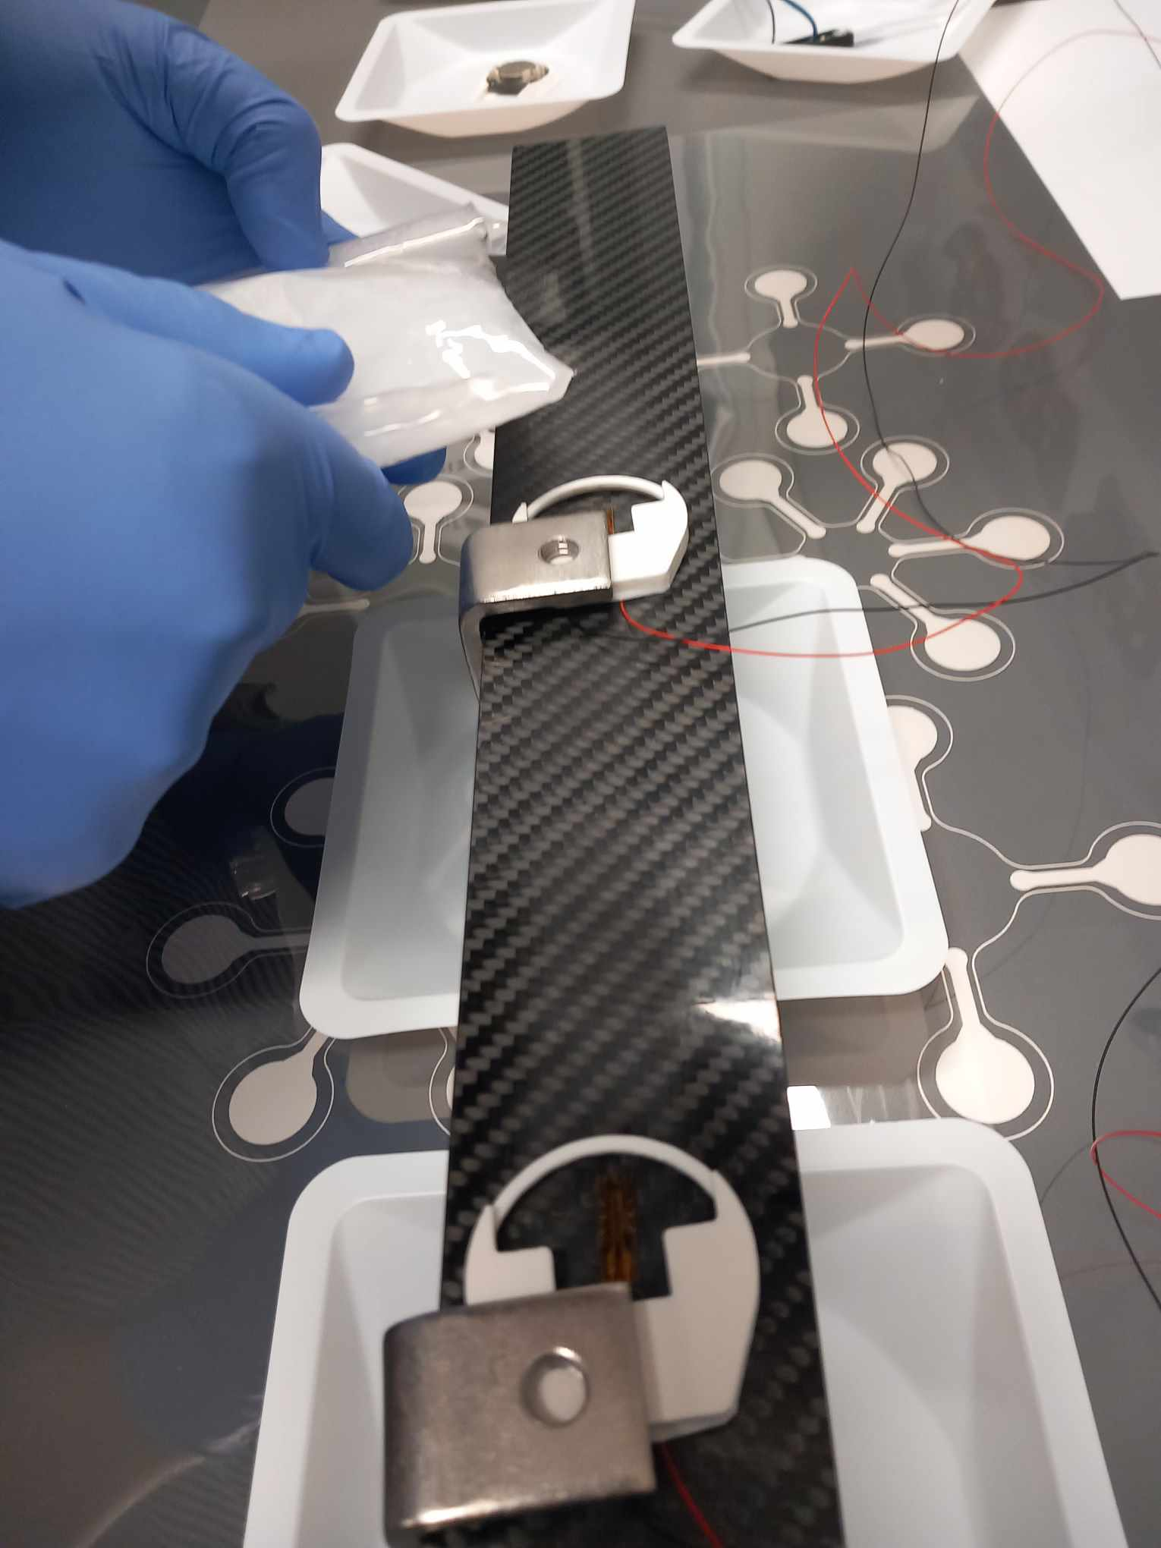
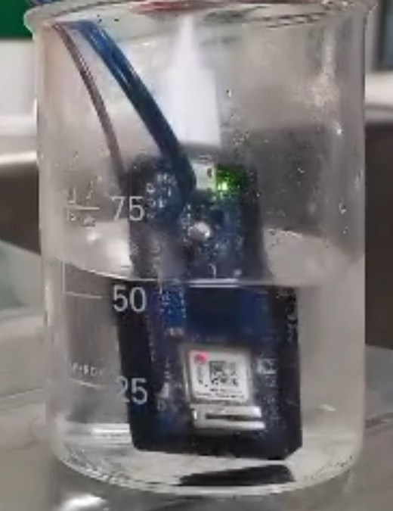
Week n°4 : May 06 to May 12
Polyurethane :
→ Discovery and study how to use it
→ Preparing experiments
→ Creation of a video for this product's use
→ Experiments testing
→ Report writing

Slide 8
W/C xxxx
Objectives
xxxxx

Slide 9
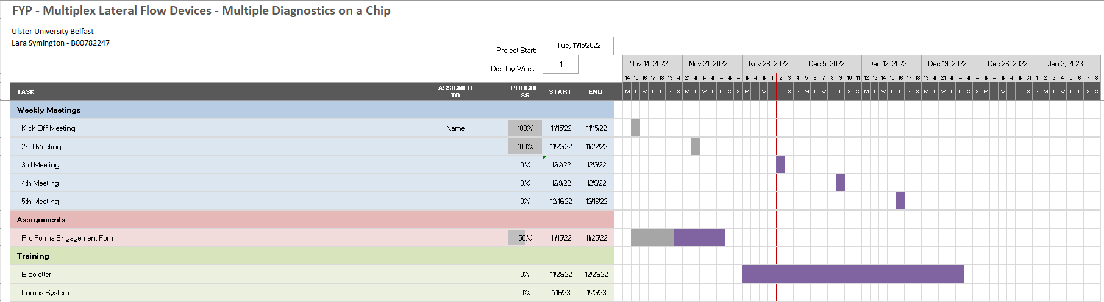
Week 1 – W/C xxxxxx

